Slide 1
CPU Scheduling Algorithm Simulator
Ethan Farkos

Slide 2
Project Overview
Develop a simulator to implement five different scheduling algorithms
Allow for user input of process details, including arrival time, CPU burst, and process priority
Visualize the scheduling process using a Gantt chart
Simulator calculates performance metrics, including average waiting time, average turnaround time, and average response time for comparison

Slide 3
Optional Features
Process information can be inputted from a text file following a specific format
Can run one or more simulations on a single set of processes
Can input a new set of processes to run a simulation on
Simulator calculates average normalized turnaround time
Can write a user-inputted process sets to a text file
Can write output to a text file

Slide 4
Design Considerations
Simulator should account for arrival times being out-of-order
Simulator should not allow:
  Zero or negative processes
  Negative arrival time
  Zero or negative CPU burst
  Negative priority
User should be able to simulate multiple algorithms on the same set of processes without having to input process info each time
User should be warned when they are about to overwrite an input or output text file

Slide 5
Process Input Feature
The user can individually input the information for each process, or they can provide the name of a text file with process information
Input File Format:
  First line contains number of processes
  Each line after defines a process and contains its arrival time, CPU burst, and priority

Slide 6
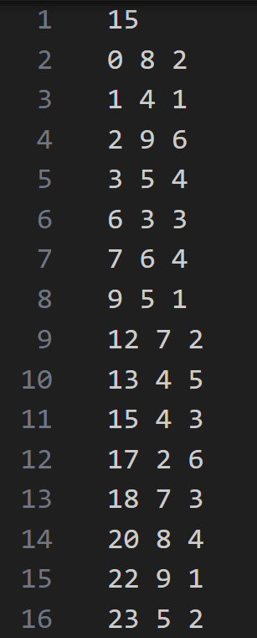
Process Set for Example Simulation
Process ID | Arrival Time | CPU Burst | Priority
P1 | 0 | 8 | 2
P2 | 1 | 4 | 1
P3 | 2 | 9 | 6
P4 | 3 | 5 | 4
P5 | 6 | 3 | 3
P6 | 7 | 6 | 4
P7 | 9 | 5 | 1
P8 | 12 | 7 | 2
P9 | 13 | 4 | 5
P10 | 15 | 4 | 3
P11 | 17 | 2 | 6
P12 | 18 | 7 | 3
P13 | 20 | 8 | 4
P14 | 22 | 9 | 1
P15 | 23 | 5 | 2

Slide 7
Performance Metrics
Wait Time: The amount of time a process spends resident in the ready queue, but not executing
Turnaround Time: The amount of time from when a ready process arrives in the queue to when it finishes executing
Normalized Turnaround Time: The ratio of a process’s turnaround time to service time (time spent executing)
Response Time: The amount of time from when a ready process arrives in the queue for the first time to when it starts executing

Slide 8
First-Come-First-Served (FCFS) Algorithm
When ready, processes join the back of a first-in-first-out ready queue
When one process finishes executing, the process that has been in the queue the longest is selected for execution

Slide 9
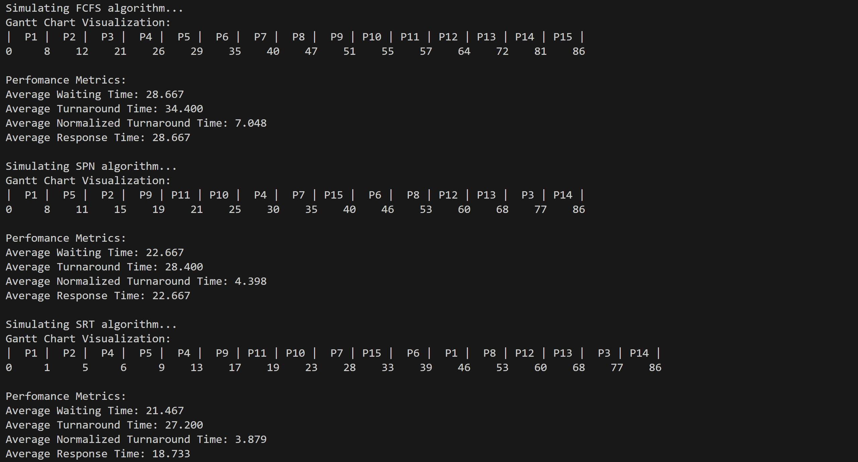
FCFS Analytics
Pros
Eliminates starvation
Minimal overhead
Cons
Shorter processes are treated unfairly if variance in execution time is high
Unfair treatment of I/O-bound processes

Slide 10
Shortest Process Next (SPN) Algorithm
When ready, processes join the back of a ready queue
When one process finishes executing, select the ready process with the shortest CPU burst
Processes with the same burst are run on a FCFS basis

Slide 11
Differences Within Simulation - SPN
Simulation places processes in queue in order of shortest remaining time, so the process at the front of the queue is the shortest process
An actual SPN implementation places the new process at the back of the queue, and when a process finishes executing, it selects the shortest process in the queue

Slide 12
SPN Analytics
Pros
High throughput
Minimal normalized turnaround time
Treats processor-bound and I/O-bound processes fairly
Cons
Starvation possible for longer processes
Must have a reasonable estimate of how long each process will take
High amount of overhead

Slide 13
Shortest Remaining Time (SRT) Algorithm
Preemptive version of SPN
The longer of the two processes (or the new process if both have an equal burst) then enters the back of the queue
When one process finishes executing, select the ready process with the shortest remaining burst
Processes with the same burst are run on a FCFS basis

Slide 14
Differences Within Simulation - SRT
Simulation places processes in queue in order of shortest remaining time, so the process at the front of the queue is the shortest process
An actual SRT implementation places the new or preempted process at the back of the queue, and when a process finishes executing, it selects the shortest process in the queue

Slide 15
SRT Analytics + Pros & Cons
Pros
High throughput
Minimal normalized turnaround time
Treats processor-bound and I/O-bound processes fairly
Cons
Starvation possible for longer processes
Must have a reasonable estimate of how long each process will take
Even greater overhead than SPN

Slide 16
Round-Robin (RR) Algorithm
Similar to FCFS except that a process is preempted to the back of the ready queue after a certain amount of time if another process is waiting for execution
Quantum: The length of a time slice a process executes before it is preempted
If no processes are waiting after an executing process finishes its quantum, it executes for another full quantum before it can be preempted

Slide 17
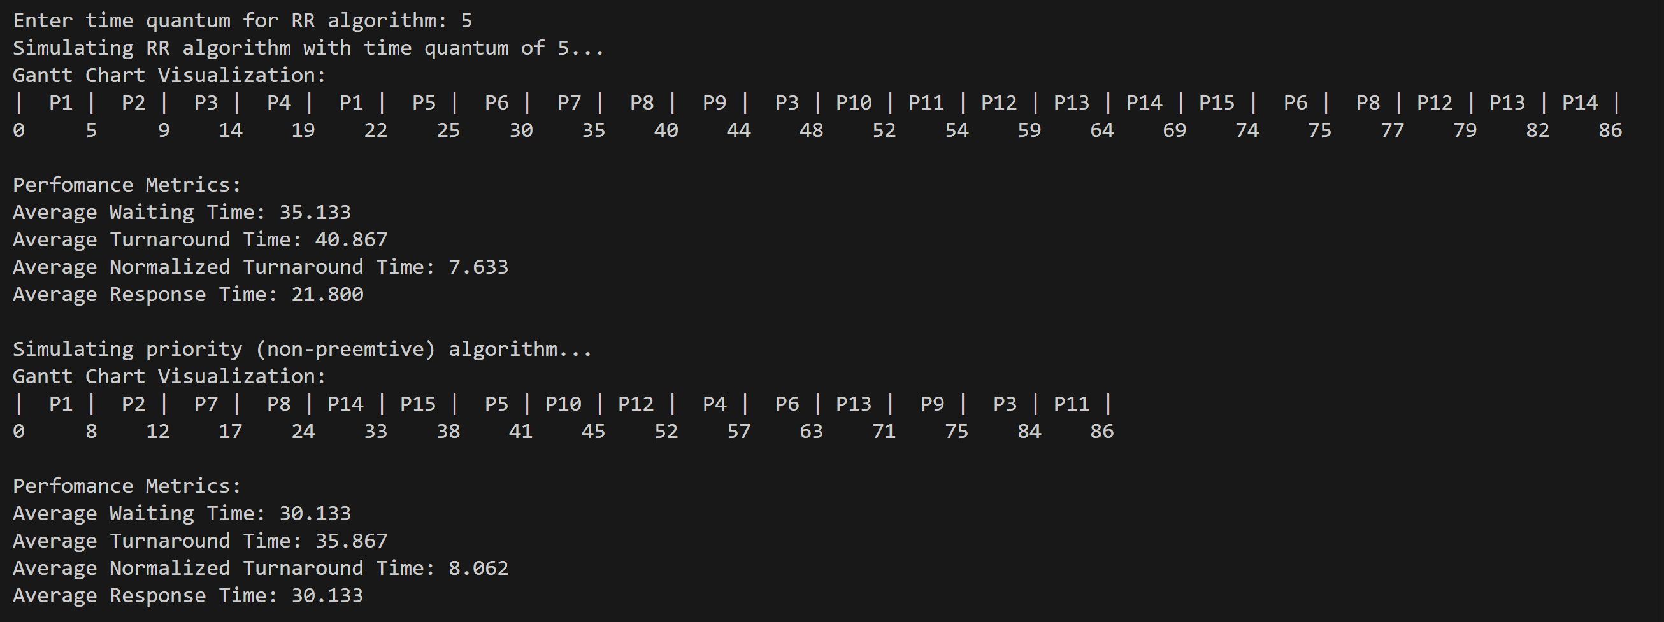
RR Analytics + Pros & Cons
Pros
Great general-use algorithm
Low overhead, albeit greater than FCFS
Cons
High normalized turnaround time for shorter processes if they have to wait a long time between quanta
Low throughput for shorter quanta
Favors processor-bound processes over I/O-bound

Slide 18
Priority (Non-Preemptive) Algorithm
When ready, processes are placed in the queue corresponding to their priority
Lower number = higher priority
When a process finishes executing, select a process from the highest-priority queue with at least one resident process
Use of priority can be combined with other algorithms to determine which process in highest-priority queue to select
For this simulation, processes of the same priority are executed on a FCFS basis

Slide 19
Differences Within Simulation - Priority
Simulation places processes in queue in order of priority, so the process at the front of the queue has the highest priority
An actual priority implementation places processes in the queue correspondent to its priority

Slide 20
Priority (Non-Preemptive) Analytics
Pros
Time-sensitive tasks can be given higher priority
Can use different algorithms in combination with priority
Cons
Starvation possible

Slide 21
Best and Worst Performers
Best Performers
Worst Performers
Average Waiting Time: SRT
Average Turnaround Time: SRT
Average Normalized Turnaround Time: SRT
Average Response Time: SRT
Average Waiting Time: RR
Average Turnaround Time: RR
Average Normalized Turnaround Time: Priority
Average Response Time: Priority

